Slide 1
Introduction to R
Part 2

Slide 2
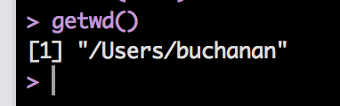
Working Directory
The working directory is where you are currently saving data in R.
What is the current working directory?
Type in getwd()
You’ll see the path for your directory
Note: I’m using a Mac.

Slide 3
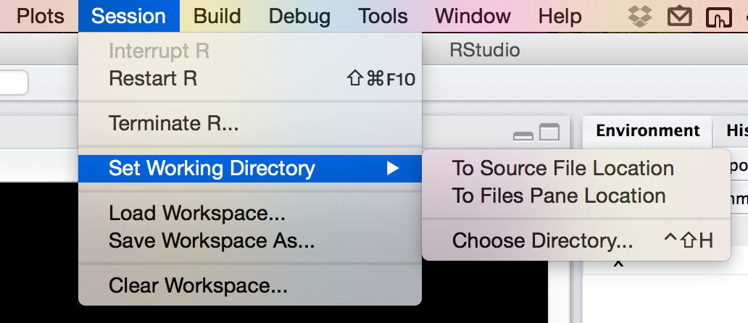
Working Directory
How to set the working directory:
setwd(“PATH”)
If you aren’t really familiar or good with using PATH values, here’s a trick:

Slide 4

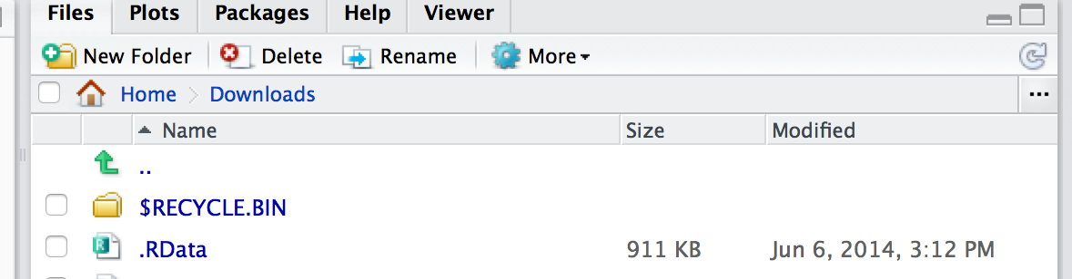
Working Directory
Now you can pick the folder you are interested in saving your files to.
Once you do that, the bottom right window will show you that folder.

Slide 5
Working Directory
Why is all this important?
You can use getwd and setwd in saved R scripts to point the analyses to specific files.
Basically, you can set it to import a file from a specific spot and use that over and over, rather than importing the file each time you open R.

Slide 6
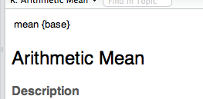
Packages
Packages are add-ons to R that allow you to do different types of analyses, rather than code them yourself.
R comes with many pre-programming functions – lovingly called base R.
At the top of the help window, you can tell which package a function is included in.

Slide 7
Packages
Packages are checked/monitored by the CRAN people.
That means there’s some oversight to them.
Many other types of functions can be downloaded from GitHub.
Use at your own risk.

Slide 8
Packages
Note: each time R updates, the packages sometimes come with it, sometimes they don’t.
If you are looking for a specific package, and it doesn’t want to install the normal way (next couple slides), but you know it exists → google it and get the TAR files.
You can install them from the TAR files.

Slide 9
Packages
How to install:
Console: install.packages(“NAME OF PACKAGE”)
Let’s try it!
install.packages(“car”)
Note: you have to be connected to the internet for packages to install.

Slide 10
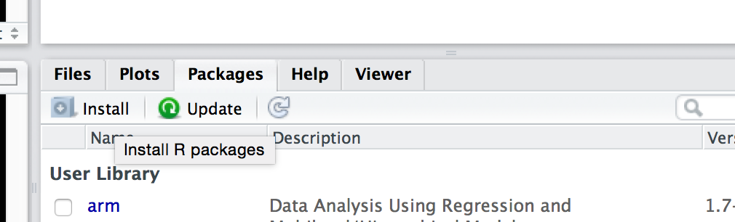
Packages
How to install:
Through RStudio
Click on packages, click on install.
Note: you can see here in this window what all you have installed, and if you click on them, you will load that help file (or click the check box to load them).

Slide 11
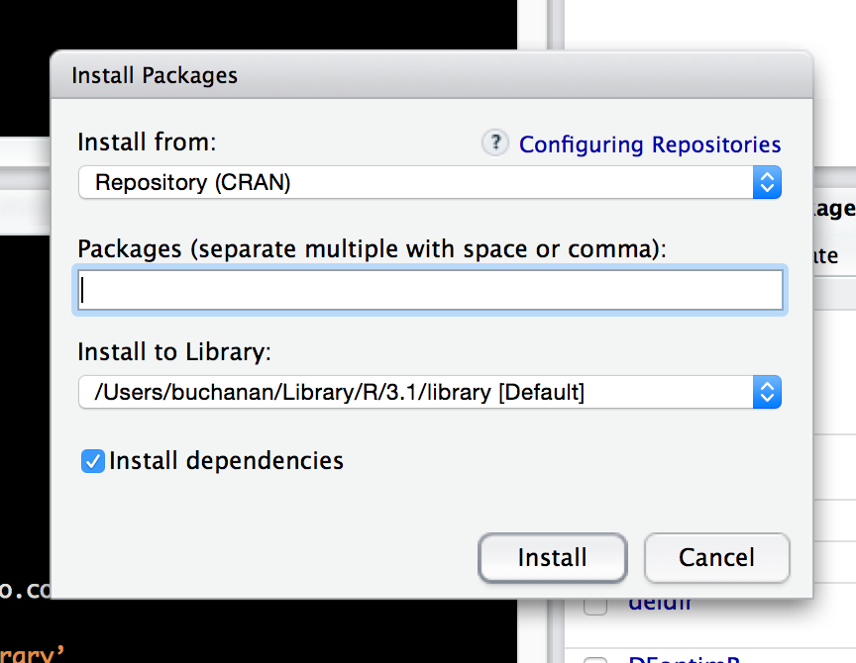
Packages
Start typing the name of the package – a drop down will appear with all the options.

Slide 12
Packages
Now it’s installed! Awesome!
That doesn’t mean that it loads every time.
Imagine this: if SPSS had a function that knew how to do regression, but it didn’t load every time.
Annoying!
But this saves computing power by not loading unless you need it.
You will run something without turning on the right package. It’s cool – all the cool kids do it.

Slide 13
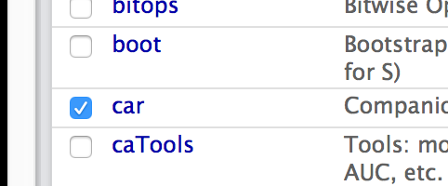
Packages
Packages are also called libraries.
You can load them two ways:
In the console: library(car) (look no “” this time).
In the packages window by clicking on the check box.

Slide 14
Packages
I suggest adding the code to your script to load the packages you need to save yourself the headache of trying to remember which ones were important.

Slide 15
Working with Files
Data files (like the airquality dataset) come with base R.
You don’t technically have to load them, but you can get them to appear in environment window by:
data(SET NAME)

Slide 16
Working with Files
If you want to see what’s available, type data()
Use the help(DATA SET NAME) or ?DATA SET NAME to see what is included/is part of the data set.

Slide 17
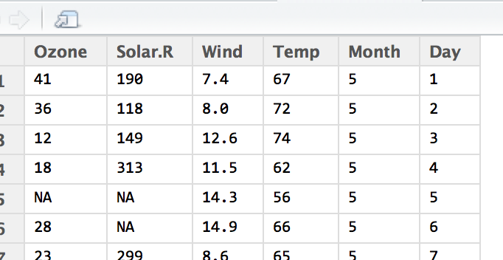
Working with Files
Data files are not nearly as visual as Excel or SPSS ☹
But RStudio can give you somewhat of a visual.
Type View(airquality) to get a visual (note V is capital)
Or click on it in
environment window

Slide 18
Working with Files
You can import all types of files, including SPSS files.
I find .csv easiest but that’s me.
You can do .txt with any separator (comma, space, tab)

Slide 19
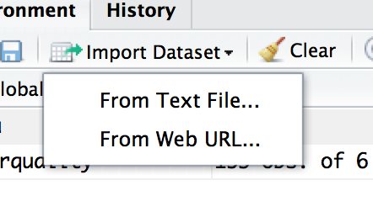
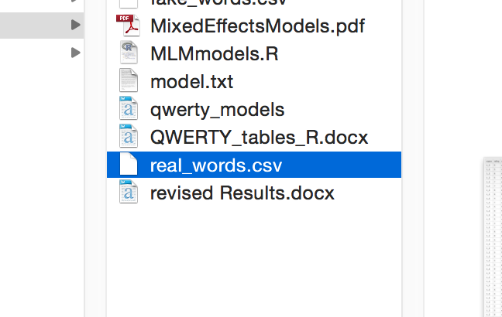
Working with Files
Import from Rstudio
Pick your file and click open

Slide 20
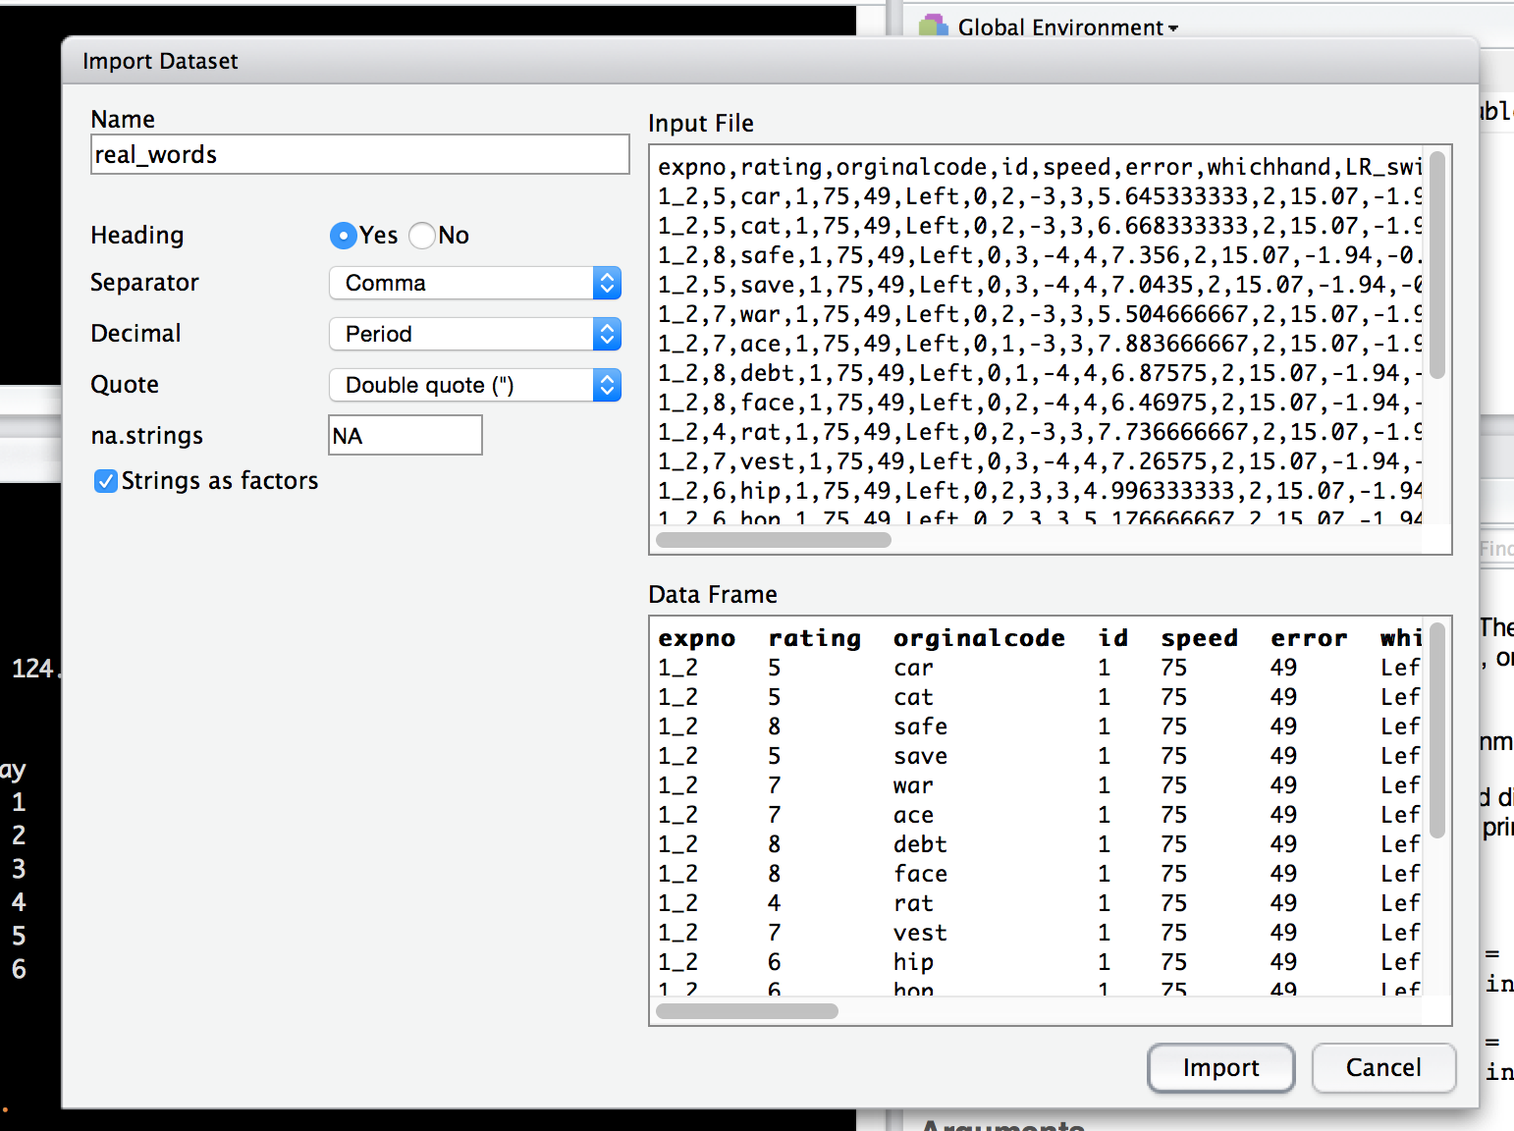
Working with Files

Slide 21
Working with Files
This process is the same as:
real_words <- read.csv(”FILE NAME")
The read.csv function – which has a lot more settings, but this process make it easy to start working with files.

Slide 22
Working with Files
You can also use the read.table function – which reads more than just csv files, allows you more flexibility in how you import the files.

Slide 23
Working with Files
Importing SPSS files.
You need the memisc package.
as.data.set(spss.system.file(SPSS DATA), use.value.labels=TRUE, to.data.frame=TRUE)

Slide 24
Working with Files
All of these options will import your data set as a data frame.

Slide 25
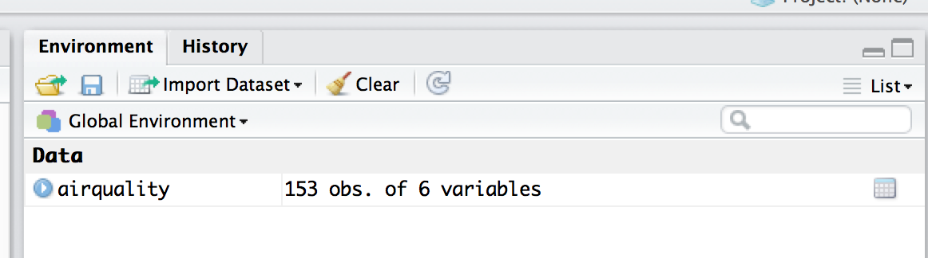
Working with Files
Clear the workspace
You don’t have to do this, but it helps if you want to start over. Click on clear in the environment window.
rm() and remove() functions do the same thing, but you have to type the object names.

Slide 26
Functions
Functions are pre-written code to help you run analyses (so you don’t have to do the math yourself!).
So there are functions for the mean, variance, z-tests, ANOVA, regression, etc.

Slide 27
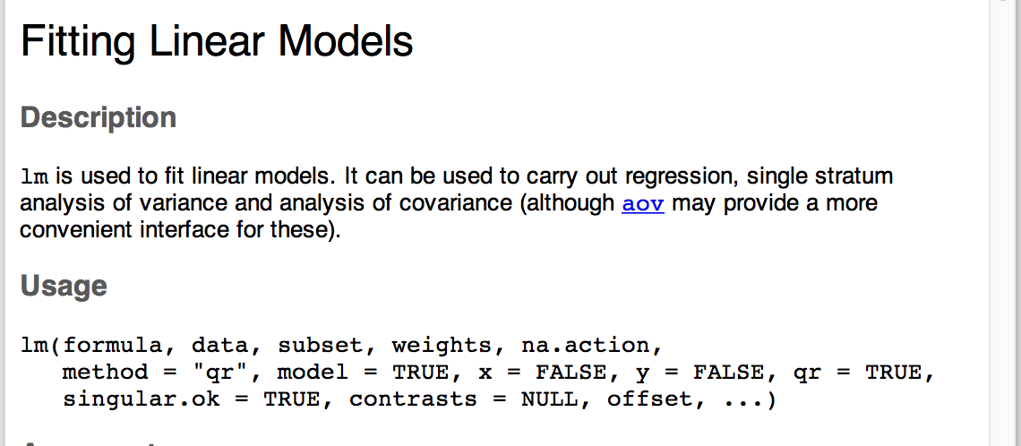
Functions
How to get help on a function (or anything really)
?function/name/thing
Try ?lm

Slide 28
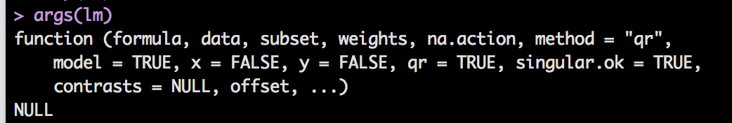
Functions
More help on functions:
help(function) – same as ?function
args(function) – tells you all the arguments that the function takes

Slide 29
Functions
What do you mean arguments?
Functions have a couple of parts
The name of the function – like lm, mean, var
The arguments – all the pieces inside the () that are required for the function to run.

Slide 30
Functions
Get help on functions:
example(function)
Gives you an example of the function in action.

Slide 31
Functions
Let’s write a very simple function to exponents.
You do have to save them, set them equal to something.
pizza = function(x) { x^2 }
You can make more complex function, adding more to the (x) part like (x,y,z).
The variables can be named anything, they just have to match in () and within the {}.

Slide 32
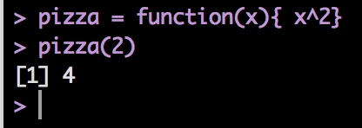
Functions
pizza = function(x) { x^2 }
This part is called the formal argument – that’s where you define the function.
pizza(2)
The actual argument – that’s where you call the function and use it.

Slide 33
Functions
Example functions:
table()
summary()
cov()
cor()
mean()
var()
sd()
scale()
recode()**
In car package
relevel()
lower2full() **
Specific to lavaan

Slide 34
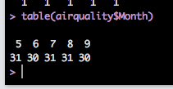
Table Function
The table function gives you a frequency table of the values in a vector/column.
table(OBJECT NAME)

Slide 35
Summary Function
The summary function has several uses:
On a vector/data frame, it will give you basic statistics on that information
On a statistical analysis, it will give you the summary output (aka the boxes you are used to looking at in SPSS).

Slide 36
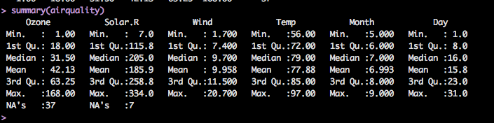
Summary Function

Slide 37
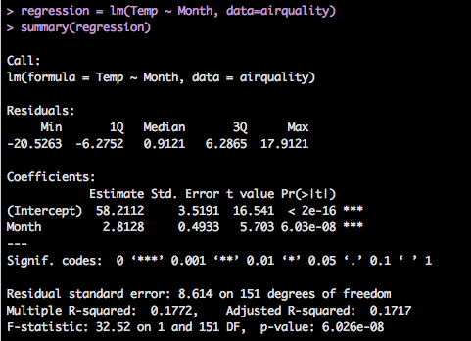
Summary Function

Slide 38
Descriptives
Basic Descriptives
cov() – covariance table
cor() – correlation table
mean() – average
var() – variance
sd() – standard deviation

Slide 39

Descriptives
Try taking the average of airquality$Ozone
mean(airquality$Ozone)
Darn!
Stupid NAs!
We’ve talked about how to deal with NAs globally, but here’s how they are handled in functions (generally)

Slide 40

Descriptives
Try this line instead:
mean(airquality$Ozone, na.rm=TRUE)
Na.rm = remove NAs ??
The default is FALSE (lame).
So you can subset the data or use that argument to tell it to ignore NAs.

Slide 41
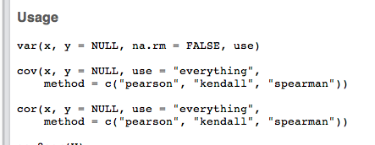
Descriptives
**when they are actually helpful that is.
Help / args are your friend**.
The var() function has na.rm
Cov() and cor() do not.

Slide 42
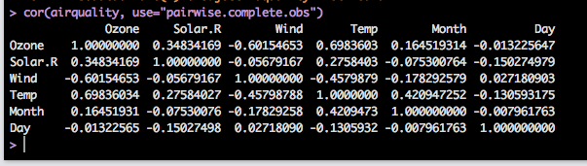
Descriptives
Try:
cor(airquality, use = “pairwise.complete.obs”)

Slide 43

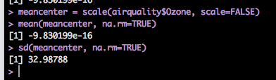
Rescoring Functions
scale() will mean center or z-score your column.
scale(VARIABLE)
Z-scored
scale(VARIABLE, scale=FALSE)
Mean centered

Slide 44
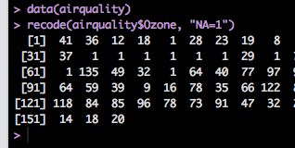
Rescoring Functions
recode() – in the car package, will allow you to reverse code/change the coding of a column
recode(COLUMN/VECTOR, “something=something”)

Slide 45
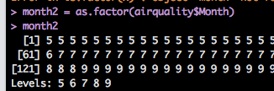
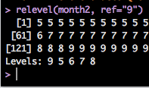
Rescoring Functions
Not quite rescoring, but super handy is
relevel()
Which allows you to change the reference group for dummy coded (factor) variables
relevel(FACTOR, ref=“GROUP NAME”)

Slide 46

Lavaan Package
We will use the lower2full function to build covariance matrices to run for SEM.
However, that function is depreciated.
So, use lav_matrix_lower2full(VECTOR OF NUMBERS)

